Slide 1

Smart Irrigation System
Team Members:
Md. Shakubul Islam Ramim
Jubayer Ahamed
Fazlay Rabbi
Irin Sultana Poly
Saba Sadia
Nahian Islam Emon

Slide 2
The Logical Design Diagram of A Smart Irrigation System

Slide 3
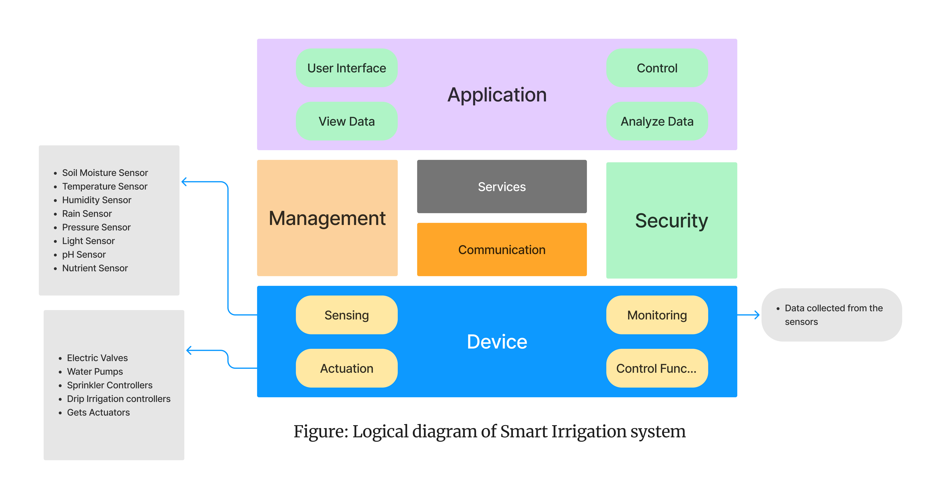
The Logical Design of a Smart Irrigation system:

Slide 4

We are looking for questions ?

Slide 5
Thank You

